Slide 1
ElasticSearch Introduction
"You know, for Search”
Dennis Riis, eBay, 2014-12-17

Slide 2

Agenda
What is ElasticSearch ?
Using ElasticSearch - simple examples
ElasticSearch .NET and NEST
Distributed search – clusters and nodes
Index configuration and schema
Text analyzers
Under the covers

Slide 3
ElasticSearch
"an end-to-end search and analytics platform.
infinitely versatile."
Notes:
ElasticSearch is not just full text search
It is also an analytics platform
Get answers such as
How many customers ordered product X last year ? Etc etc
What are the mean order value …

Slide 4
The ELK stack
ElasticSearch
Elasticsearch is a flexible and powerful open source, distributed, real-time search and analytics engine.
Logstash
Logstash helps you take logs and other time based event data from any system and store it in a single place for additional transformation and processing.
Kibana
Kibana is Elasticsearch’s data visualization engine, allowing you to natively interact with all your data in Elasticsearch via custom dashboards.
Notes:
We are going to talk about ElasticSearch today
* Touch briefly on logstash and Kibana

Slide 5
ElasticSearch
Open source, founded in 2010
Java (cross platform)
JSON over HTTP
Builds on Apache Lucene

Slide 6
Lucene vs Elastic
Lucene
ElasticSearch
Is a Java class library for search
Is not distributed
Integration using Java code
Filesystem based
Manage scaling manually
"very complicated"
Builds on top of Lucene
Is built for distribution
Uniform RESTful HTTP API
High availability, durable
Scales out
Easy to use

Slide 7
What is a search engine ? (for our purposes)
A system capable of searching through large amounts of data very fast
Knows about text (’full text search’) – not just about matching exact values
ElasticSearch, FAST and SOLR are search engines
MSSQL is NOT a search engine
In some literature called ”information retrieval system”

Slide 8
Getting started
Download ElasticSearch
Change the default cluster name in the .config file
Run it (you must have Java installed)
Or
Use a pre-built Vagrant virtual machine, there are several available
(or Docker)

Slide 9
How to use ElasticSearch
ElasticSearch uses a REST interface over HTTP with JSON data
HTTP methods are mapped as you would expect
You can PUT something to a URL
GET the same URL to get it back
DELETE to delete it.
HEAD to check existence.
Examples (Sense)
Index a document
Perform a search
Notes:
Go to simple usage demo here
Remember to introduce Sense.

Slide 10
How to use ElasticSearch
From .NET
ElasticSearch .NET
Low-level – exposes methods corresponding to the REST endpoints
NEST
High-level, opinionated
Notes:
Show LINQPad demos

Slide 11
Queries vs filters
Queries generally are for full-text searches that should affect document ranking
Filters are for yes/no matches
Filters can be cached by ElasticSearch and should be preferred for making exact matches
Such as selecting the brand and model
Or filtering a price range

Slide 12
Aggregations
Some times called facetting
Can be used to analyze the data in ElasticSearch
Sum, min, max, std.dev and many more and advanced operators
Or generating search navigators
Aggregations can run pre- or post filters

Slide 13
Distributed search – cluster and nodes
When we code against Elastic, we connect to a cluster
A cluster consists of one or more nodes
A node is typically one machine with ElasticSearch installed
But, for development purposes:
A cluster can be one node
A cluster can be on one machine with many nodes (instances of Elastic)
Notes:
We should round-robin requests between nodes
Expected to be setup by SiteOps via loadbalancer.

Slide 14
Clusters & nodes
Allows us to scale out by adding more nodes
Provides availability and resiliency against failure.
In a correctly configured Elastic cluster:
A number of nodes can fail (hw/network) without data loss
- And without affecting availability

Slide 15
Clusters & nodes
A cluster is a set of nodes (instances of ElasticSearch) sharing the same cluster.name, set in the config
By default, the cluster will automatically discover new nodes and start using them.
This is done using multicast communication on the network, so spinning up a new node with an existing cluster.name will join it to the cluster.

Slide 16
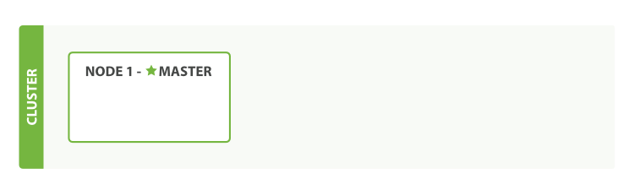
Clusters and nodes
The cluster elects a master node, taking care of master-level operations
Any node can be the master

Slide 17
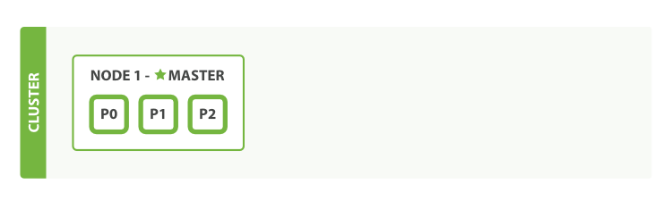
Clusters and nodes
A node has a number of indexes, each consisting of a number of Shards.
Notes:
P0, P1, P2 = Shard

Slide 18
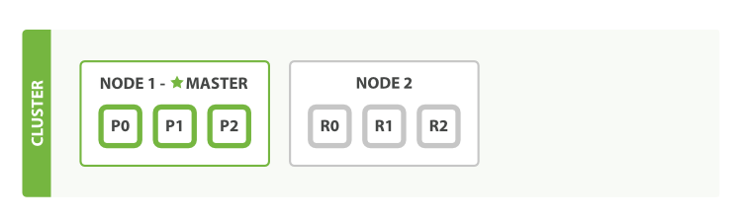
Clusters and nodes
Adding node(s) immediately cause ElasticSearch to start replicating shards to the new node

Slide 19
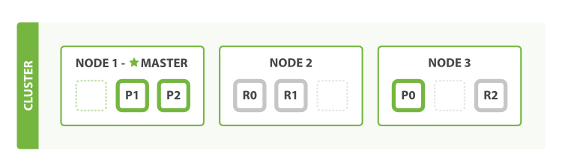
Scaling out
Writes happen to the primary node first, then on the replicas
If we lose a node with a primary shard, one of the replicas will be promoted to primary
GET by Id only needs to touch the node the document is stored on
Searches happen on all nodes in parallel
Both replicas and primaries can serve search requests

Slide 20
Cluster health
GET _cluster/health
Green – all indexes are up with the number of replicas active as assigned when creating the index
Yellow – all indexes are up, but the required number of replicas is not
Red – shards missing
This can also be queried on index or shard level
Notes:
Demo spinning up some nodes. Remember to shutdown local vagrant first
vagrant suspend
Store some data on one node. Then spin up another. Show status goes to green.
----- Meeting Notes (15/12/14 20:10) -----
Talk about that we can still search even in red mode

Slide 21
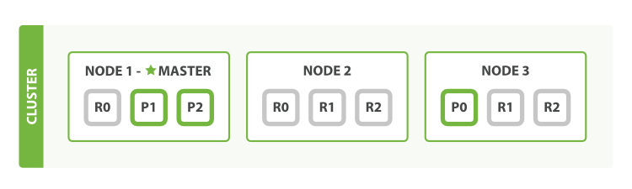
Scaling some more
Number of replicas can be increased per-index
Allows us to distribute load on demand when adding nodes

Slide 22
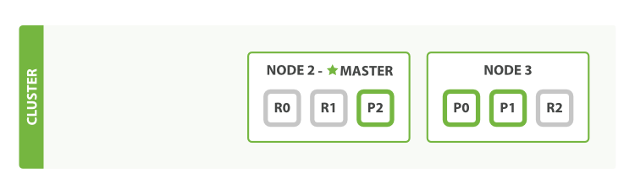
Losing a node
If we lose a node, replicas can be promoted to primaries
Replicas never live on the same node as their primary
Or, we never have 2 copies of the same data on the same node
If we want 2 replicas we need at least 3 nodes

Slide 23
Types & Mappings
The mapping is part of the index configuration, and it tells ElasticSearch how to store each property for each type. This is the schema.
If you just write to an index without defining the mapping, ElasticSearch will create a mapping for you.
ElasticSearch tries to do the right thing …
… and that works great for demos …

Slide 24
Types and mapping
ElasticSearch deduces the mapping when it first encounters a type
Which may not be what you want
Notes:
Mappings demo start here

Slide 25
Types & mappings
ElasticSearch supports the following simple types:
String: string
Whole number: byte, short, integer, long
Floating-point: float, double
Boolean: boolean
Date: date
Notes:
Show mapping demo here

Slide 26
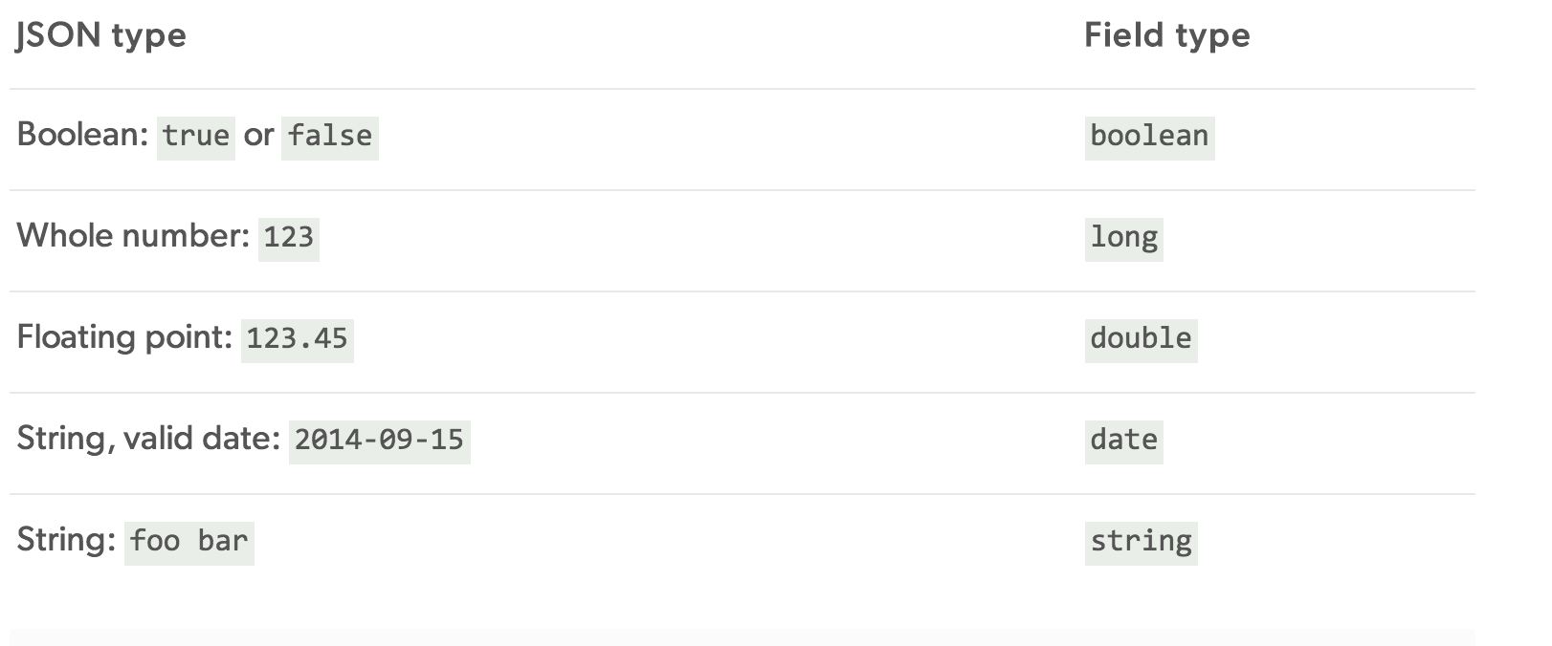
Dynamically deduced types

Slide 27
Arrays
All fields can be an array (ie. have none, one, or many values)
All elements in an array must have the same type

Slide 28
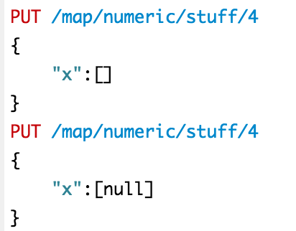
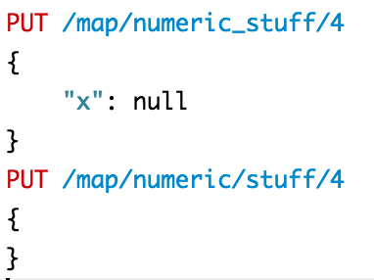
Nulls
Null is stored as the absence of a value
No difference between omitting the field or setting it to null
These are functionally equivalent:
But notice that _source is stored as the exact document that was input. It’s only the search index that collapses nulls.

Slide 29
Dynamic mapping options
Per type, can be
True (default)
When ES encounters a new field in a type, automatically create it in the index
False
When ES encounters a new field in a type, silently ignore it (!)
Strict
Throw an exception if an unknown field is encountered
This might actually be what you want !

Slide 30
Strings & Exact values
Exact values are … exact values
One way to interpret
Easy to match on
Numbers, bools, dates are exact values
Strings can be exact values
Or analyzed text for ‘full text search’

Slide 31
Exact matching vs full text search
Exact matching
Is boolean – it either matches or it does not
Full text search
Does not need to match exactly the text in the query
Includes a relevancy score – how well does the document match the query ?
Searches in tokens instead of considering a field to be one value

Slide 32
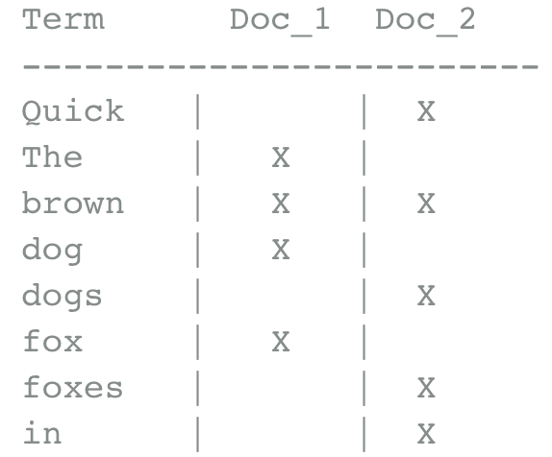
How does full text search work ?
Convert the input string into tokens and put them into an inverted index.
The inverted index is essentially a sorted list of unique tokens,
In which we record which documents contain each term

Slide 33
The inverted index
Searching for “quick brown”
Term Doc_1 Doc_2
-------------------------
Quick | | X
The | X |
brown | X | X
dog | X |
dogs | | X
fox | X |
foxes | | X
in | | X
jumped | X |
lazy | X | X
leap | | X
over | X | X
quick | X |
summer | | X
the | X |
------------------------
Term Doc_1 Doc_2
-------------------------
brown | X | X
quick | X |
------------------------
Total | 2 | 1

Slide 34
Normalizing the index
Some words are considered equal – synonyms
Disregard casing
Throw away punctuation
Reduce words to their root words
Fox and foxes -> Same word
Dog and dogs -> Same word

Slide 35
Normalizing the index
Term Doc_1 Doc_2
-------------------------
Quick | | X
The | X |
brown | X | X
dog | X |
dogs | | X
fox | X |
foxes | | X
in | | X
jumped | X |
lazy | X | X
leap | | X
over | X | X
quick | X |
summer | | X
the | X |
------------------------
Term Doc_1 Doc_2
-------------------------
brown | X | X
dog | X | X
fox | X | X
in | | X
jump | X | X
lazy | X | X
over | X | X
quick | X | X
summer | | X
the | X | X
------------------------

Slide 36
The query must be normalized as well
The query must be normalized in the same way as the indexed fields
Otherwise we won’t be able to match correctly

Slide 37
Analysis
The process of tokenization and normalization is called analysis
This is highly configurable in ElasticSearch and needs to be tuned for the application and content
ElasticSearch ships with a number of analyzers, and
More can be downloaded (often for $$$)
you can write your own (in Java)

Slide 38
Configuring analysis
A string field is analyzed by default
If you want to use a string field for exact matching, you must set it to be notAnalyzed
This can be configured per mapping
Notes:
Go to demo here

Slide 39
Analyzers
Analyzers can be
Character filters
Tokenizers
Token filters
Analyzers can be combined as a chain
The analyzer for a field can be set in the mapping
Analyzer API
Handy for testing out analuzers without re-running indexing
Notes:
Show analyzer demo here

Slide 40
Built in analyzers
Standard analyzer
Default, best general choice
Simple
Splits terms on non-letters and lowercases the terms
Whitespace
Splits terms on whitespace. Doesn’t lowercase
Language specific
Language specific analysis (stemming, stop words, etc) for specific languages
Many default languages, including danish

Slide 41
Other index-level options
# shards (default = 5)
Index “building block” – more on that later
Cannot be changed later !
# replicas (default = 1)
Can be changed after creating the index
For reliability – as long as we have at least 1 replica, the full data set is available
For load distribution
Each replica lives on one node. Any replica (node) can serve a search request.
If you only have 1 index, but 8 nodes in the cluster, setting # of replicas to less than 7 makes no sense – you would just have idle nodes without data on them.
Notes:
Fact-check “each replica lives on one node”.

Slide 42
Type level options
_source: Whether to store the _source field or not
Default yes, generally a good idea to keep it
_all: Whether to index a _all field consisting of all the fields concatenated
Default yes, enables some “simple search” scenarios where you don’t need to specify field name
_include_in_all (per field)
Whether to include the field in _all, default yes

Slide 43
Index management
You can think of the index as the schema of the search engine
Index changes should be scripted at deploy-time (just like database schema changes)
Index changes should be idempotent
Remember to think about order. Can new code work with the old index or only the new one ?

Slide 44
Under the covers - shards
The data in an index is put in a number of shards
The shard is the lowest-level worker-unit managed by ElasticSearch
A shard is a Lucene index by it’s own right

Slide 45
Under the covers - shards
The shards contain a inverted index for each field
These inverted indexes are immutable:
Avoids the need for locking
Better cacheable by the filesystem
Caches remain valid for the life of the index (so cache management is much easier)
Allows for compression

Slide 46
Lucene segments (inside shards)
In order to overcome the downsides of immutability, such as having to write the entire index to disk again,
Lucene has the concept of segments
A shard is actually a collection of segments + a commit point.
A segment is collection of Lucene inverted indexes made searchable
When adding to the Lucene index, a new index is written, and a commit point is added.
Search happens across all segments at once

Slide 47
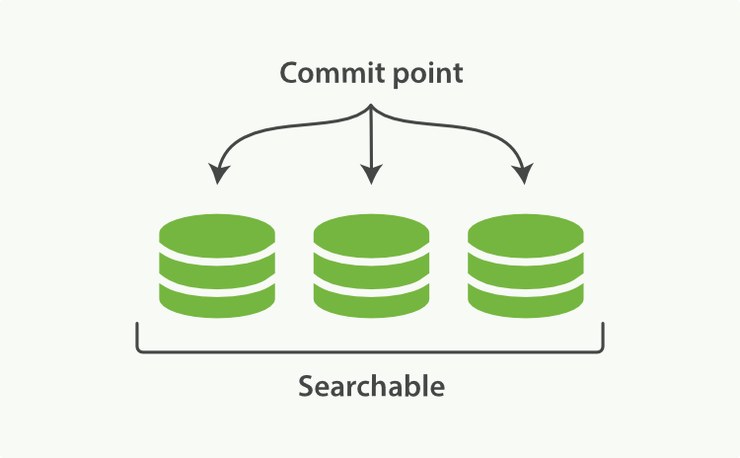
Lucene segments (inside shards)

Slide 48
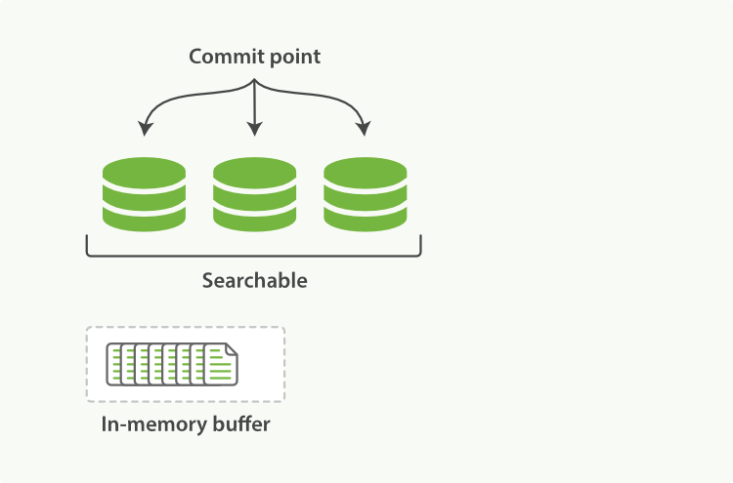
Lucene segments (inside shards)
Notes:
New documents are put into the index buffer
Every so often the buffer is committed to disk, creating a new segment

Slide 49
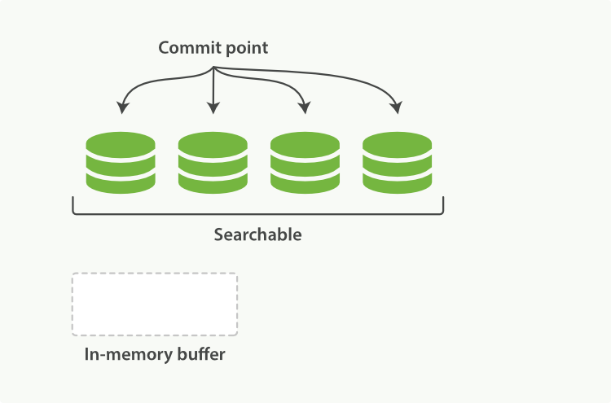
Lucene segments (inside shards)
Notes:
Everything is flushed to disk, the segment is “opened” and a commit point is added.
The in-memory buffer is flushed.

Slide 50
Lucene segments – handling deletes
Deletion doesn’t actually delete documents from the segments (they’re immutable !)
Deleted documents are marked as deleted by being listed in a .del file beside the segment
Deleted documents can still match a search, but they are filtered out before results are returned

Slide 51
Lucene segments – handling updates
Updates work like deletion
The updated document is marked as deleted in it’s segment
Then a new version is added in a new segment

Slide 52
Committing updates
While documents are in the in-memory buffer; they are not searchable
Committing them to disk is costly
Lucene has a compromise, where data is written to disk, but not fsync’ed (flushed to actual disk, data might be sitting in FileSystem buffers)
This is called a refresh
Notes:
Fsync is costly

Slide 53
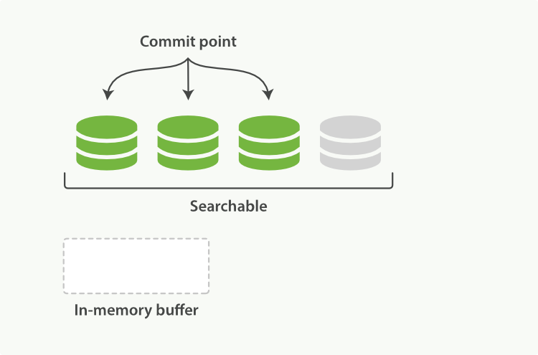
Documents are searchable after a refresh
Notes:
… but not committed !!

Slide 54
‘near real time search’
Every shard is refreshed automatically every second
Documents does not become searchable before being refreshed
From insertion time until next refresh, you can’t search the document
But you can CRUD it.

Slide 55
Refresh API
You can force a refresh by calling the refresh API
Works for all indexes or a specific one
Not to be used in production !!
But useful for integration tests
The refresh time can also be configured per index
Lower refresh times obviously causes performance penalties
Not all data needs a refresh time of once per second
Automatic refresh can also be turned off
Notes:
For instance, for logging you could set the refresh time much higher than once per second
Turn off automatic refresh could be useful for massive updates to an index, then turn it back on when you are ready to start using it.
Refresh interval demo. -1 = disabled; 1 = 1 millisecond !!!. Use durations like “1s” = one second or “2m” = 2 minutes.

Slide 56
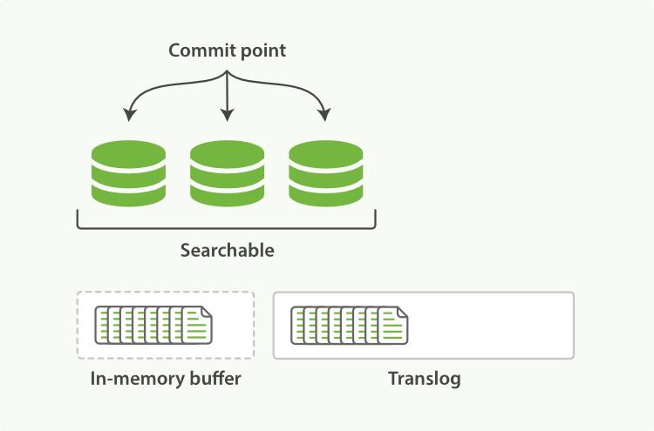
Transaction log
Notes:
Transaction log used to avoid losing data
Fsync’ed every 5 seconds

Slide 57
Transaction log
Conceptually, just like the MSSQL Server Transaction log
Records every operation that has happened
After a restart (or power failure), transaction log is used to repopulate the in-memory buffer
Documents are not lost, even though they weren’t written to the segment

Slide 58
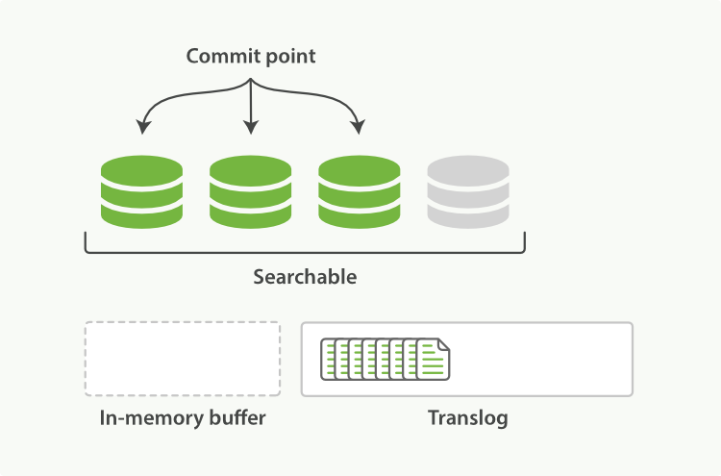
Transaction log after refresh
Notes:
We can’t be sure the last segment has actually not hit the disk. So keep those documents in the transaction log

Slide 59
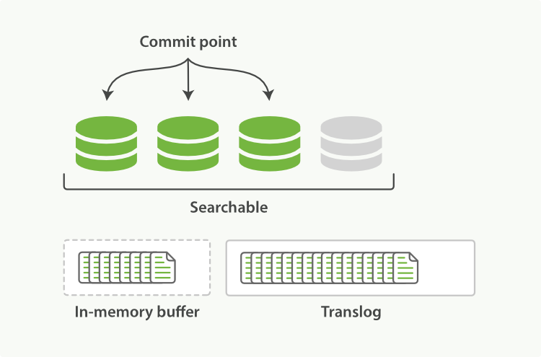
Transaction log after refresh
Notes:
The transaction log can keep accumulating documents after a refresh

Slide 60
Flush (full commit)
Flushes all data to disk (fsync)
Writes a commit point as a list of segments that have been committed
Transaction log is deleted
The commit point are used by ElasticSearch at startup time to identify the segments that should be loaded
Notes:
So is data then lost at power failure ? No, transaction log to the rescue.

Slide 61
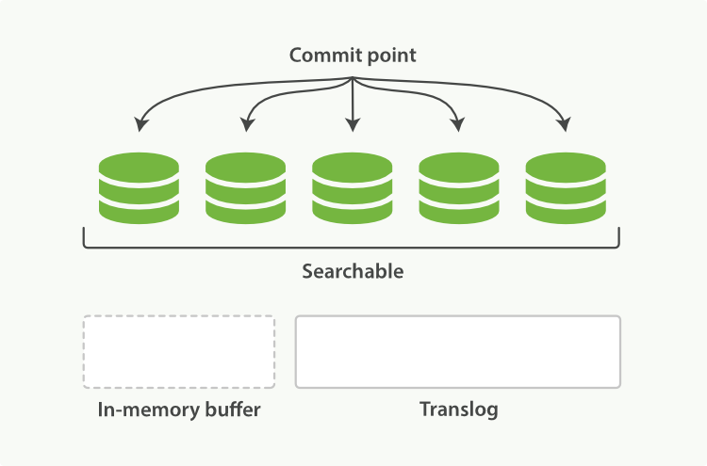
Flush

Slide 62
Flush API
Flushes happen when the translog gets too big,
Or every 30 minutes by default
You can explicitly flush an index using the flush api
Default flushing automatically should be fine
But it can be beneficial to flush a node before restarting it – avoiding the operations of replaying the transaction log.
Notes:
Defaults for “too big” are:
Index.translog_flush_threshold_ops = unlimited
Index.translog_flush_threshold_size = 200 MB
Index.translog_flush_threshold_period = 30 minutes
Index.translog.interval = 5s (how often to check if translog should be flushed)
Index.gateway.local.sync = how often the translog is fsync’ed to disk = 5s.

Slide 63
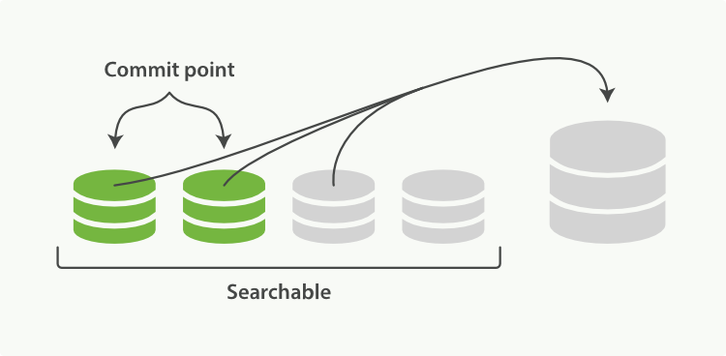
Segment merging
We’re adding a segment per second
ElasticSearch automatically merges segments for us in the background
Notes:
If we weren’t doing merging, the number of segments would grow wildly

Slide 64
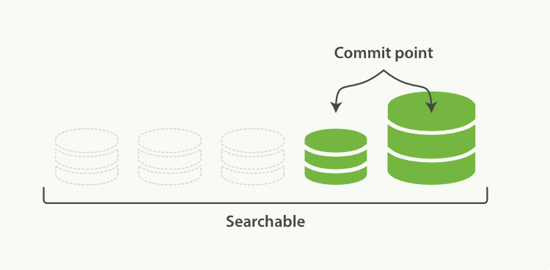
Segment merging
Because segments are immutable, this can be done safely without interrupting search operations
But it uses a log of CPU and IO
Notes:
Show merging video
https://www.youtube.com/watch?v=YW0bOvLp72E

Slide 65
Optimize API
Forces a merge down to the number of max_num_segments
Not throttled !
Should typically not be used for an active index receiving traffic (updates) – let the background process do it’s job
But if an index stops receiving updates, it could be good to optimize it
Such as for timeseries based indexes, like for logstash

Slide 66
Segment merging
If possible for your data types and flow, it makes sense to organize indexes in order to reduce merging
For instance, for timeseries based data (logs being the canonical example):
Create a new index per time unit
Only the current index will receive updates and need merging
Which means a much smaller dataset participates in merging, requiring less IO and CPU
Notes:
Show segment merging video

Slide 67
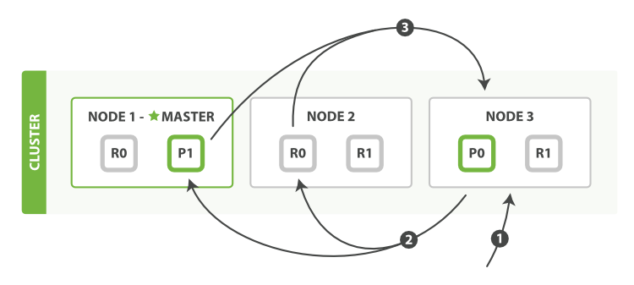
Distributed search execution
Query phase
Notes:
Node 3 receives the request and becomes the coordinating node
Each shard must return enough docIDs to potentially fulfill the query – full documents are not returned
The prioritzed list is merged by the coordinating node

Slide 68
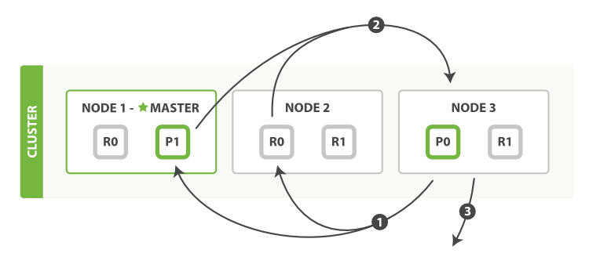
Distributed search execution
Fetch phase
Notes:
Coordinating node knows which documents need to be fetched from each shard
It issues a multi-GET request to each shard and combines the list.
Then the results can be returned to the client.

Slide 69
A note about pagination
Each client must build a priority queue consisting of from + size elements
The coordinating node must handle a list of
(number of shards) * (from + size) elements
This can be very costly. Deep pagination this way is discouraged
(but up to 10 – 50.000 hits should be OK)

Slide 70
Distributed search - options
preference
Allows controlling which shards particpate in the search request
Supports stuff like _primary, _prefer_node:xyz, etc.
Set to something unique per user to avoid bouncing results problem
Timeout
Set the timeout per node
If one node is slow, don’t affect the overall search experience
At the cost of missing results

Slide 71
Distributed search - options
routing
Limit search to a number of shards
Useful if you already have custom routing of document
search_type
count : Only do query phase. The result can only be a count, or aggregations
query_and_fetch: Default, what we just outlined
dfs_query_then_fetch: Better relevance calculation at the cost of an extra roundtrip (don’t use)
scan: Used for scan & scroll
Notes:
Dfs_query_then_fetch: Use a prequery phase to fetch the term frequencies from all involved shards in order to calculate global term frequencies.
http://www.elasticsearch.org/guide/en/elasticsearch/guide/current/relevance-is-broken.html

Slide 72
Scan and scroll
A way to effectively page out all results
But disables sorting !
Create a scroll that is open for a time period. This works like a snapshot of the data. You get a _scroll_id returned
Call ES repeatedly with the _scroll_id to get the next batch of results
Notes:
Useful for getting data out of ES in manageable chunks

Slide 73

What’s next ?
ElasticSearch e-Book free to read:
http://www.elasticsearch.org/guide/en/elasticsearch/guide
Or videoguides on www.elasticsearch.org
Today we covered, more or less, the “getting started” chapter from the guide
There’s a lot more to learn about ES !

Slide 74
What we didn’t cover (most important topics)
Aggregations (in depth)
Geosearch
.percolator
Relevance calculation and fine tuning
Performance tuning and parameters
Memory and scaling considerations
Administration, monitoring, deployment

Slide 75
Any Questions ?
(thanks for your time)

